Slide 1
ICMP: internet control message protocol

Slide 2
The IP protocol has no error-reporting or error-correcting mechanism. The IP protocol also lacks a mechanism for host and management queries. The Internet Control Message Protocol (ICMP) has been designed to compensate for the above two deficiencies. It is a companion to the IP protocol.

Slide 3
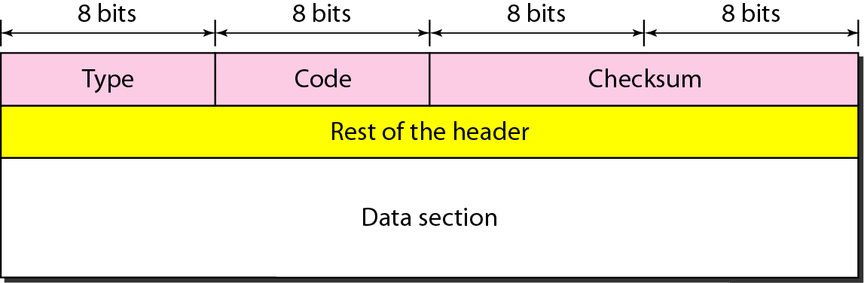
Figure 21.8 General format of ICMP messages

Slide 4

Note
ICMP always reports error messages to the original source.

Slide 5
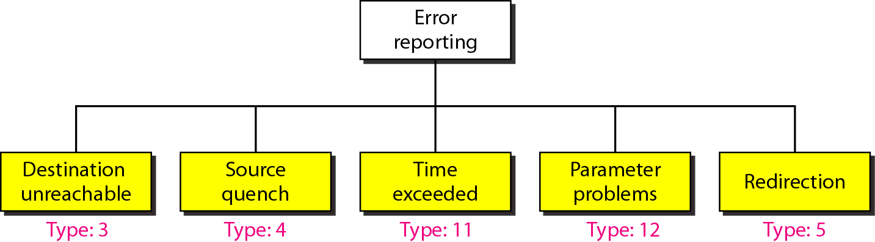
Figure 21.9 Error-reporting messages

Slide 6
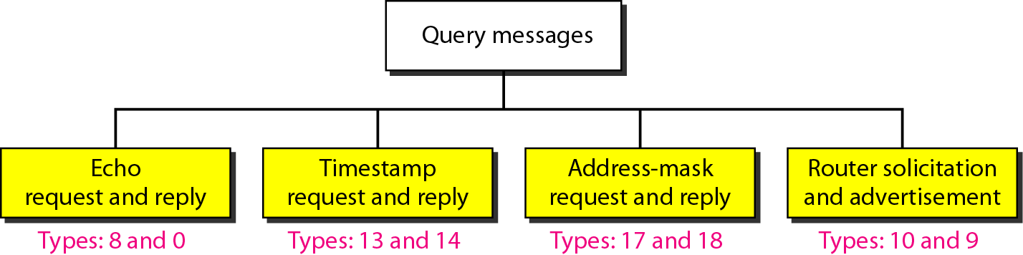
Figure 21.12 Query messages

Slide 7
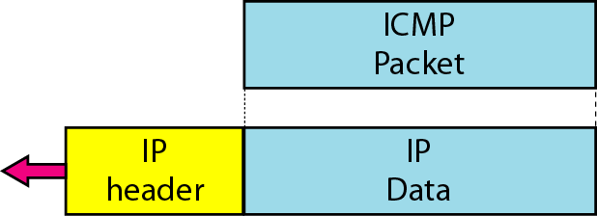
Figure 21.13 Encapsulation of ICMP query messages

Slide 8
Example 21.2
Figure 21.14 shows an example of checksum calculation for a simple echo-request message. We randomly chose the identifier to be 1 and the sequence number to be 9. The message is divided into 16-bit (2-byte) words. The words are added and the sum is complemented. Now the sender can put this value in the checksum field.

Slide 9
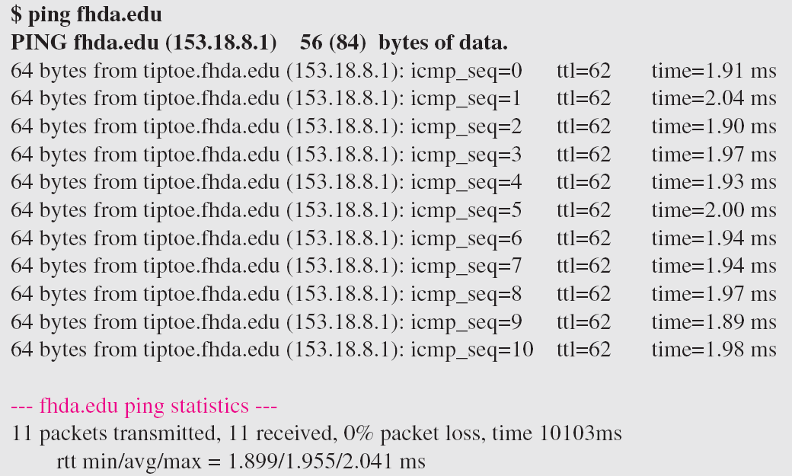
Example 21.3 (continued)

Slide 10
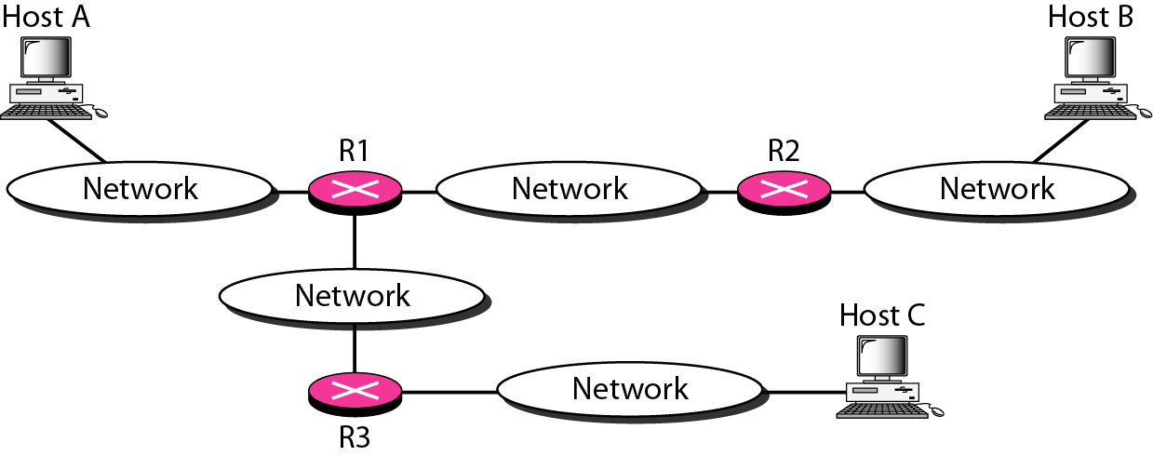
Figure 21.15 The traceroute program operation

Slide 11
Example 21.4
We use the traceroute program to find the route from the computer voyager.deanza.edu to the server fhda.edu. The following shows the result:
The unnumbered line after the command shows that the destination is 153.18.8.1. The packet contains 38 bytes: 20 bytes of IP header, 8 bytes of UDP header, and 10 bytes of application data. The application data are used by traceroute to keep track of the packets.

Slide 12
Example 21.4 (continued)
The first line shows the first router visited. The router is named Dcore.fhda.edu with IP address 153.18.31.254. The first round-trip time was 0.995 ms, the second was 0.899 ms, and the third was 0.878 ms. The second line shows the second router visited. The router is named Dbackup.fhda.edu with IP address 153.18.251.4. The three round-trip times are also shown. The third line shows the destination host. We know that this is the destination host because there are no more lines. The destination host is the server fhda.edu, but it is named tiptoe.fhda.edu with the IP address 153.18.8.1. The three round-trip times are also shown.

Slide 13
Example 21.5
In this example, we trace a longer route, the route to xerox.com (see next slide). Here there are 17 hops between source and destination. Note that some round-trip times look unusual. It could be that a router was too busy to process the packet immediately.

Slide 14
Example 21.5 (continued)

Slide 15
ICMP: internet control message protocol
used by hosts & routers to communicate network-level information
error reporting: unreachable host, network, port, protocol
echo request/reply (used by ping)
network-layer “above” IP:
ICMP msgs carried in IP datagrams
ICMP message: type, code plus first 8 bytes of IP datagram causing error
Type Code description
0 0 echo reply (ping)
3 0 dest. network unreachable
3 1 dest host unreachable
3 2 dest protocol unreachable
3 3 dest port unreachable
3 6 dest network unknown
3 7 dest host unknown
4 0 source quench (congestion
control - not used)
8 0 echo request (ping)
9 0 route advertisement
10 0 router discovery
11 0 TTL expired
12 0 bad IP header

Slide 16

Traceroute and ICMP
source sends series of UDP segments to dest
first set has TTL =1
second set has TTL=2, etc.
unlikely port number
when nth set of datagrams arrives to nth router:
router discards datagrams
and sends source ICMP messages (type 11, code 0)
ICMP messages includes name of router & IP address
when ICMP messages arrives, source records RTTs
stopping criteria:
UDP segment eventually arrives at destination host
destination returns ICMP “port unreachable” message (type 3, code 3)
source stops
3 probes
3 probes
3 probes

